Slide 1
SAKTHIVEL E
ENROLL NO: EBEON0921448470
BATCH CODE: 6141
PROJECT NAME: STOCK MANAGEMENT SYSTEM

Slide 2
CONTENT
INTRODUCTION
PROBLEM STATEMENT
FEATURES
SOFTWARE REQUIREMENTS
PROGRAM
OUTPUT
ADVANTAGES
CONCULSION

Slide 3
INTRODUCTION
The “STOCK MANAGEMENT SYSTEM “is for manage and analysis the Stock.
It help to us where we want to buy and sell a stack.
Its gives a benefit and misfortune investigation .
The main idea is all the user want to gain the profit amount than the invested
amount.

Slide 4
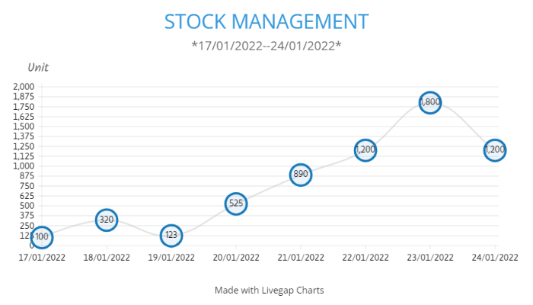
STOCK DATA OF MARUTI SUZUKI

Slide 5
PROBLEM STATEMENT
The “Stock Management System “is to overcome problems to identity where we invest a amount and where we sell a stock.
By using this we easy Gain the profit in stock market.
Every user has easy analysis through this concept to invest a amount to gain profit.

Slide 6
FEATURES
The “Stock Management System” is an application to automate the process of managing information help user for analysis.
In this concept three different user buying and selling here stock and gaining profit.
Every user differ from other so I use to show some different between the types of stocker for our analysis.

Slide 7
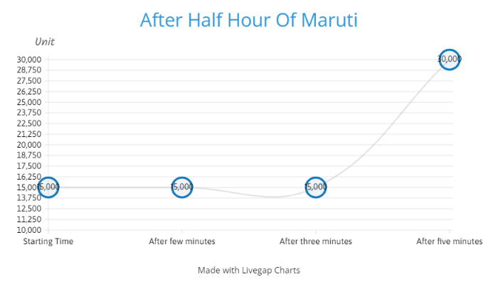
In this graph, stock start at 15000,user
wait for candlestick goes down , but its
does goes up.
Here user has wait so long to buy a stock ,user buy at same price at 15000.
Then users want to sell a stock but candlestick still at some price candlestick up some bit high , here user get some profit.

Slide 8
SOFTWARE REQUIREMENTS
SOFTWARE : Eclipse , JDK
LANGUAGE : Core Java
OPERATING SYSTEM : Windows 10

Slide 9
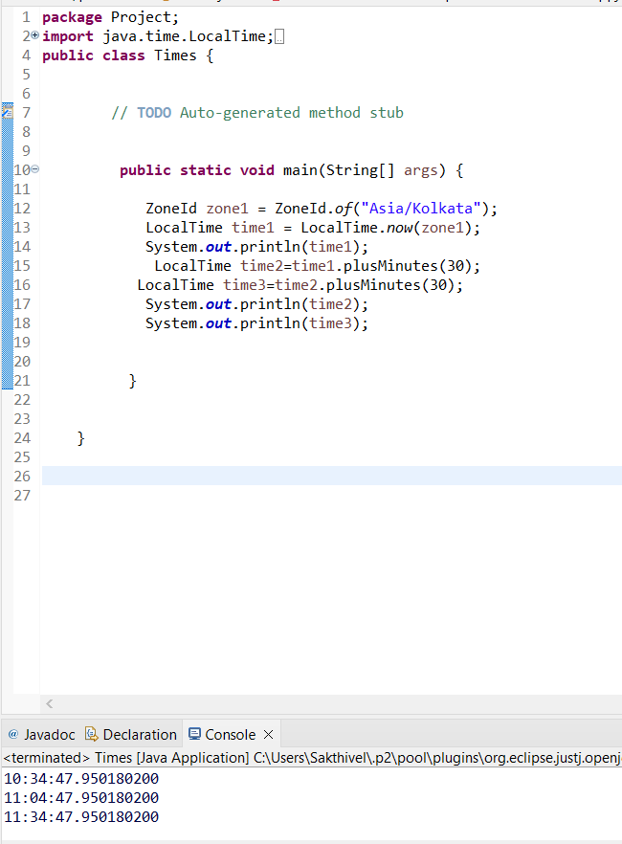
PROGRAM
By using Zone Id and Local Time display a output with varies time.
In Stock Management its help to notes varies number of stock and manage to invest.
Depends upon time is very easily to buy and sell a stock to gain a profit.

Slide 10
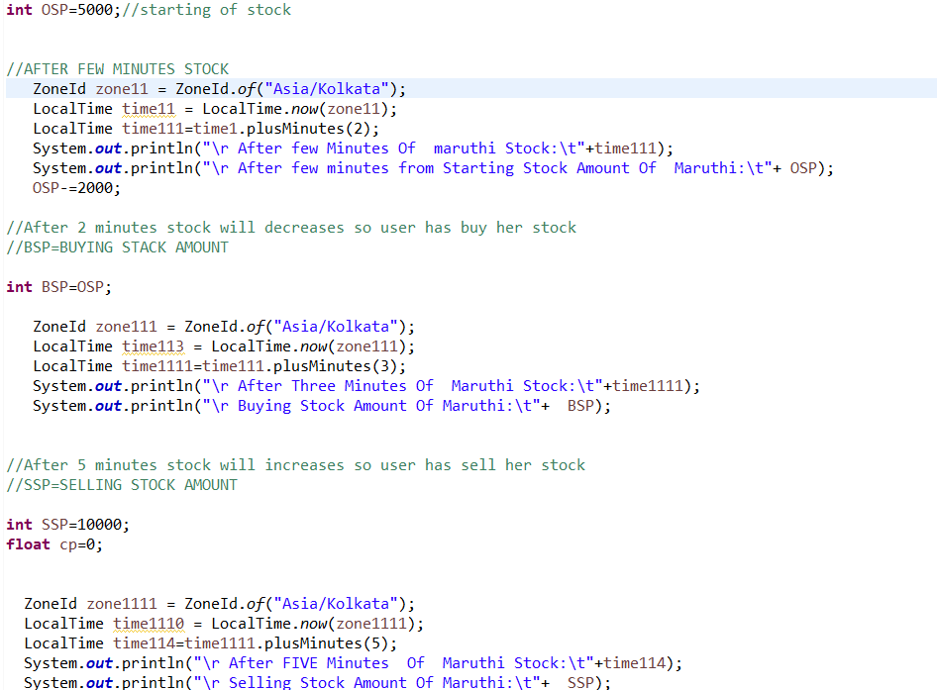
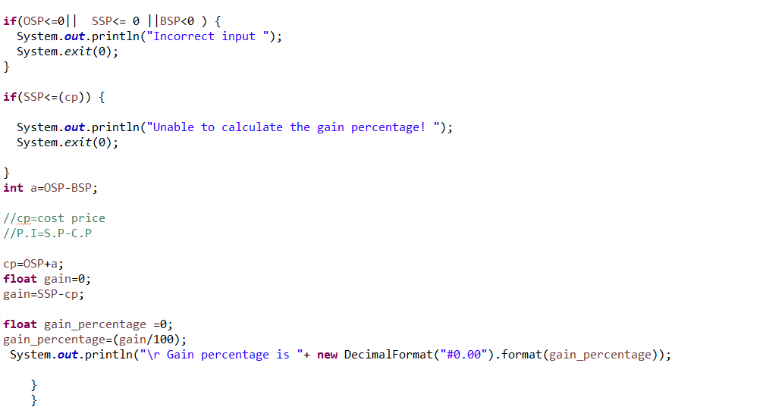

Slide 11
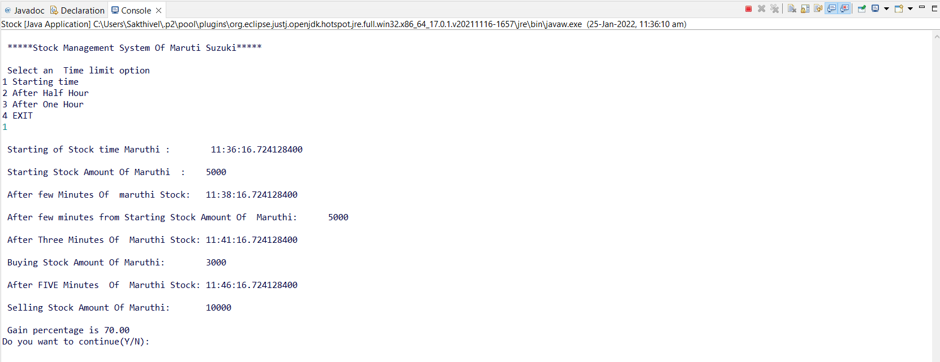
OUTPUT

Slide 12
ADVANTAGES
User Friendly STOCK Management.
Easy To Use and Understand by every user.
The software will display view calculations of every minutes with gain percentage.

Slide 13
CONCULSION
Stock Management System takes the necessary choice to
the user according to their invest.
It is very good and reliable system which can be in Co operate to the chain of stock marketing so can easily maintained and analyses.

Slide 14
THANK YOU

